Slide 1







Foundations of Technology
Engineering Design Journal
Teacher Resource – Day 4
© 2016 International Technology and Engineering Educators Association
STEM Center for Teaching and Learning™
Foundations of Technology
Notes:
© International Technology Education Assoc
Slide #<number>
TITLE SLIDE
12/01/2009
STEMCenter for Teaching & Learning™ Engineering byDesign™

Slide 2

The BIG Idea
Big Idea:
Engineering Design Journals (EDJ) are used to record and document all intellectual property when developing solutions to engineering problems.
© 2016 International Technology and Engineering Educators Association
STEM Center for Teaching and Learning™
Foundations of Technology
Notes:
[Authors: Please include teacher notes appropriately.]
© International Technology Education Assoc
Slide #<number>
12/01/2009
STEMCenter for Teaching & Learning™ Engineering byDesign™

Slide 3

The Engineering Design Journal
© 2016 International Technology and Engineering Educators Association
STEM Center for Teaching and Learning™
Foundations of Technology
Notes:
[Authors: Please include teacher notes appropriately.]
© International Technology Education Assoc
Slide #<number>
12/01/2009
STEMCenter for Teaching & Learning™ Engineering byDesign™

Slide 4
The Engineering Design Journal
Setting Up the Engineering Design Journal:
  Have students number each page, starting with the first page.
  Numbering should be done on the front and back of each page.
  Label page one as “Table Of Contents.”
  Label page four as “Engineering Design Journal Rules,” and begin recording notes.
© 2016 International Technology and Engineering Educators Association
STEM Center for Teaching and Learning™
Foundations of Technology
Notes:
[Authors: Please include teacher notes appropriately.]
© International Technology Education Assoc
Slide #<number>
12/01/2009
STEMCenter for Teaching & Learning™ Engineering byDesign™

Slide 5
What is an Engineering Design Journal?
An engineer’s notebook is used to record ideas, inventions, experiments, records, and observations. It is a vital record of your work.
Each student is required to have his or her own engineer’s notebook. He or she will record all related project work by hand.
© 2016 International Technology and Engineering Educators Association
STEM Center for Teaching and Learning™
Foundations of Technology
Notes:
[Authors: Please include teacher notes appropriately.]
© International Technology Education Assoc
Slide #<number>
12/01/2009
STEMCenter for Teaching & Learning™ Engineering byDesign™

Slide 6
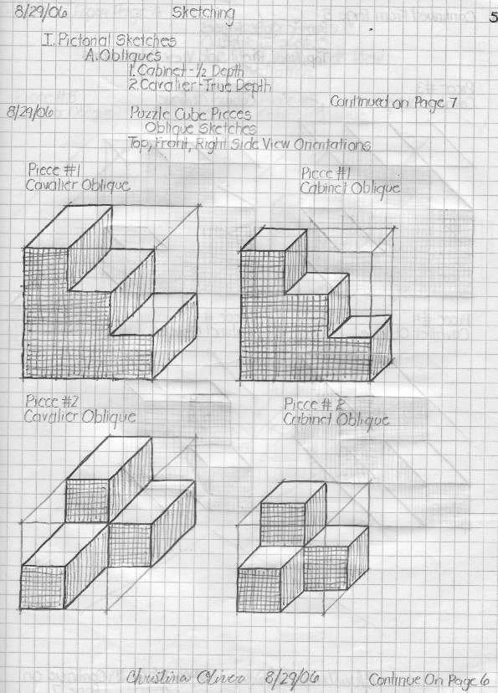
The Engineering Design Journal
An engineer’s notebook records:
  A chronological account of all projects
  Notes
  Annotated Sketches
  Research
  Records/Test Procedures
© 2016 International Technology and Engineering Educators Association
STEM Center for Teaching and Learning™
Foundations of Technology
Notes:
[Authors: Please include teacher notes appropriately.]
© International Technology Education Assoc
Slide #<number>
12/01/2009
STEMCenter for Teaching & Learning™ Engineering byDesign™

Slide 7
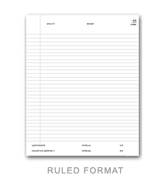
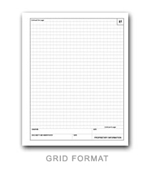
The Engineering Design Journal
Standard Page Layout:
  Can be a ruled or grid format
  Includes labeled page numbers
  Signature and date line (typically at bottom of page)
  Witness signature and date line (typically at bottom of page)
  Open section of page to record notes, records, experiments, etc.
© 2016 International Technology and Engineering Educators Association
STEM Center for Teaching and Learning™
Foundations of Technology
Notes:
[Authors: Please include teacher notes appropriately.]
© International Technology Education Assoc
Slide #<number>
12/01/2009
STEMCenter for Teaching & Learning™ Engineering byDesign™

Slide 8
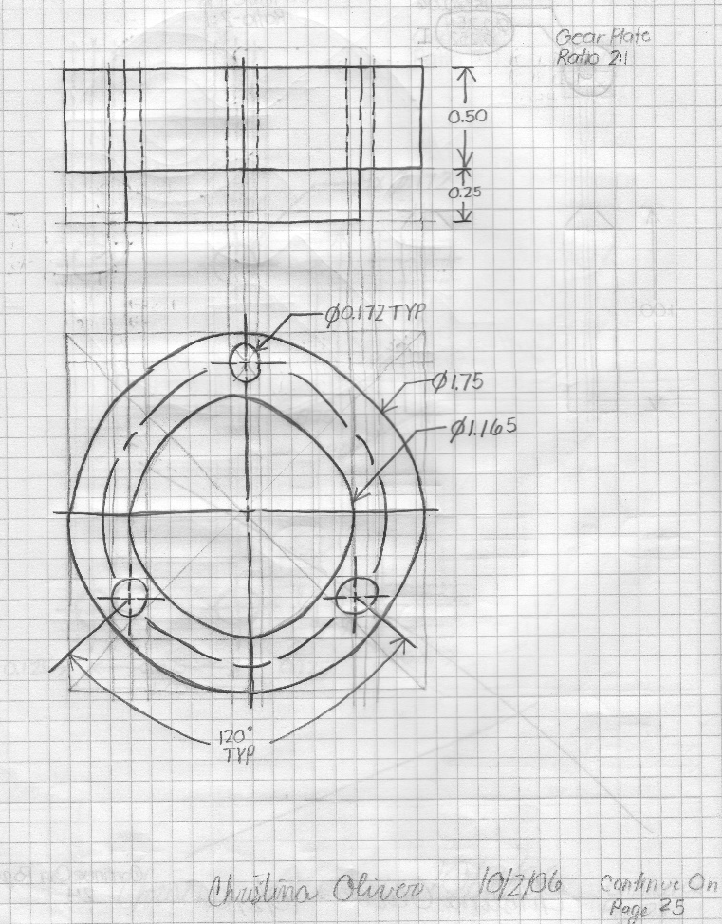
Engineering Design Journal Rules
Record all entries in permanent ink.
Record all concepts, results, and references in a logical manner.
Label all figures and calculations.
© 2016 International Technology and Engineering Educators Association
STEM Center for Teaching and Learning™
Foundations of Technology
Notes:
[Authors: Please include teacher notes appropriately.]
© International Technology Education Assoc
Slide #<number>
12/01/2009
STEMCenter for Teaching & Learning™ Engineering byDesign™

Slide 9
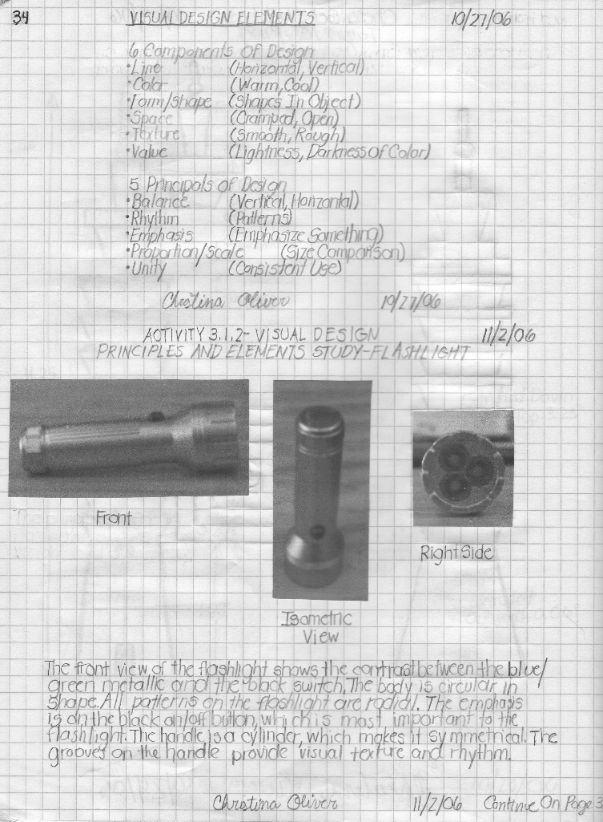
Engineering Design Journal Rules
Do not remove pages from your notebook.
You can supplement your entries with supporting material, but you must permanently fix those materials inside your notebook.
Sign and date each page before moving to the next page.
© 2016 International Technology and Engineering Educators Association
STEM Center for Teaching and Learning™
Foundations of Technology
Notes:
[Authors: Please include teacher notes appropriately.]
© International Technology Education Assoc
Slide #<number>
12/01/2009
STEMCenter for Teaching & Learning™ Engineering byDesign™

Slide 10
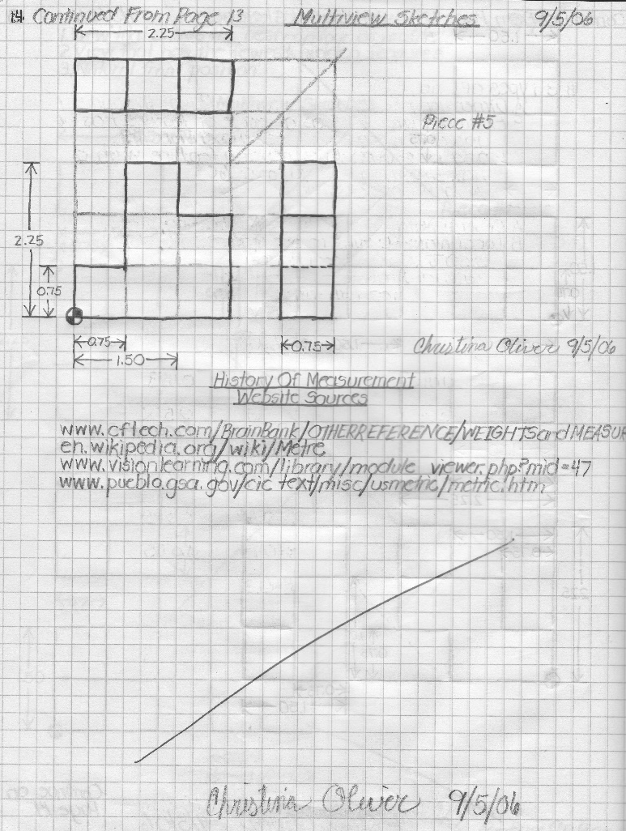
Engineering Design Journal Rules
Start entries at the top of the page and work left to right and down the page.
Do not erase errors; cross through mistakes with a single line.
Never leave blank space on a page; mark all unused space.
© 2016 International Technology and Engineering Educators Association
STEM Center for Teaching and Learning™
Foundations of Technology
Notes:
[Authors: Please include teacher notes appropriately.]
© International Technology Education Assoc
Slide #<number>
12/01/2009
STEMCenter for Teaching & Learning™ Engineering byDesign™

Slide 11
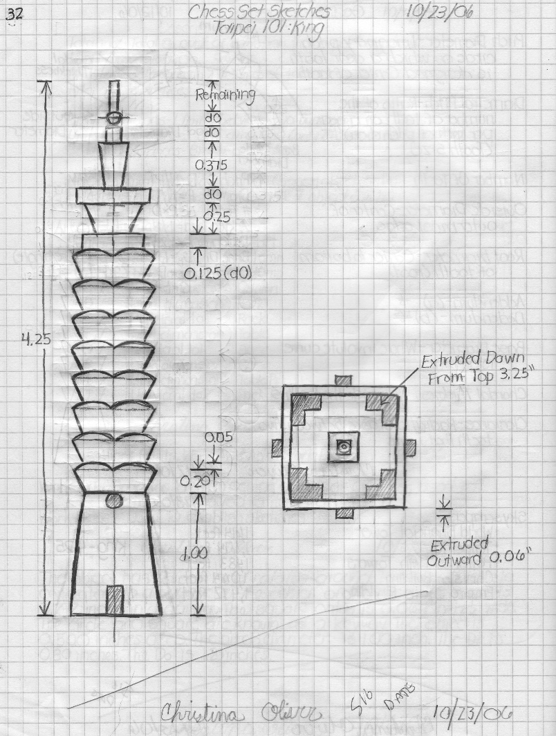
Engineering Design Journal Rules
Annotate all sketches.
An engineering notebook can also be kept electronically.
Remember to Sign and Date each page when finished.
© 2016 International Technology and Engineering Educators Association
STEM Center for Teaching and Learning™
Foundations of Technology
Notes:
When students are completed taking notes, have them sign and date the bottom of the notes page.
© International Technology Education Assoc
Slide #<number>
12/01/2009
STEMCenter for Teaching & Learning™ Engineering byDesign™

